Slide 1
Service-Now TechDoc

Slide 2
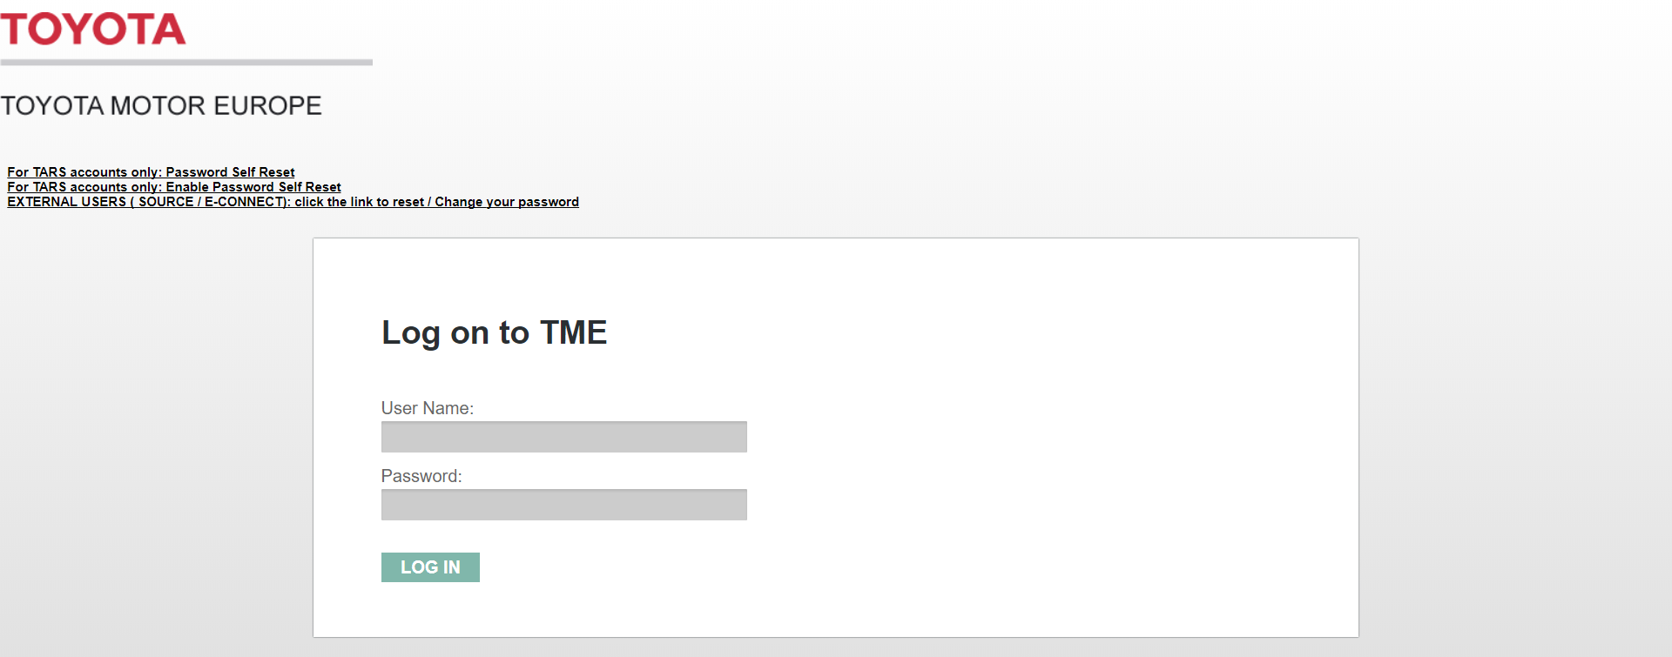
URL & Log In
https://toyotaeurope.service-now.com/

Slide 3
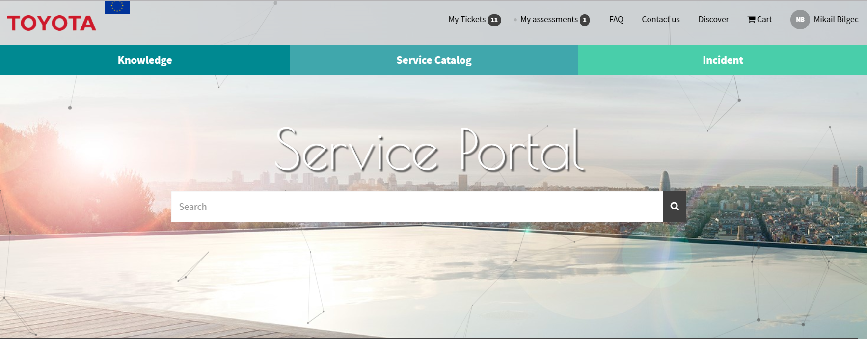
NAVIGATION
Homepage

Slide 4
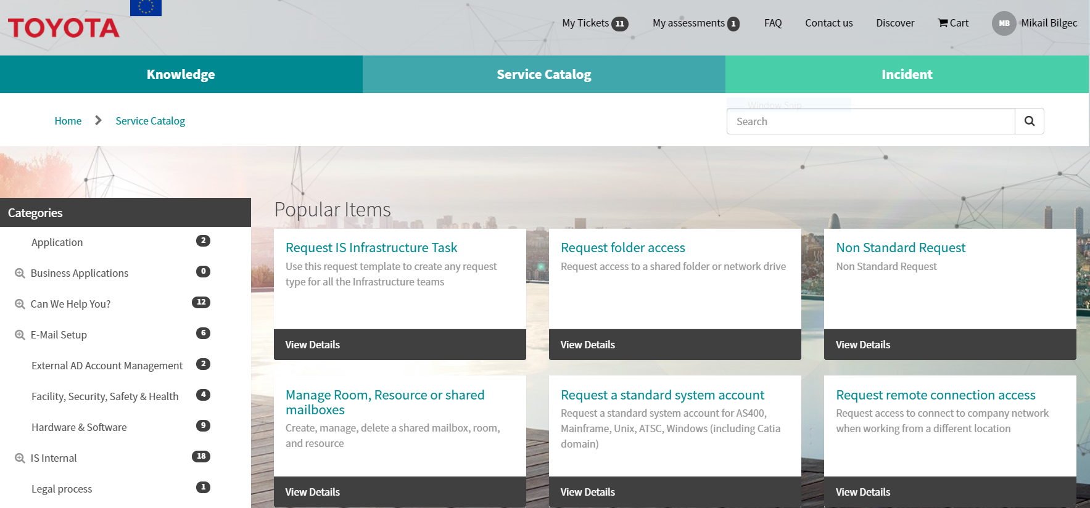
NAVIGATION
Homepage

Slide 5
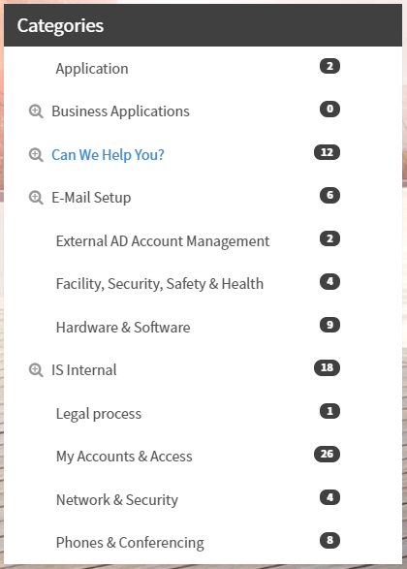
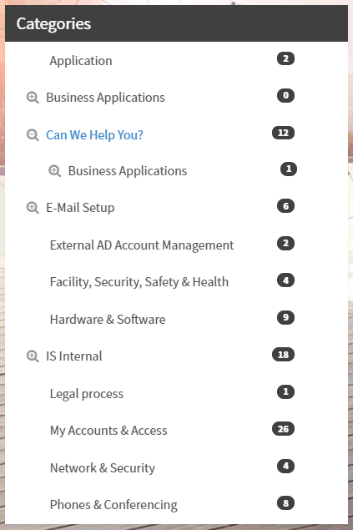
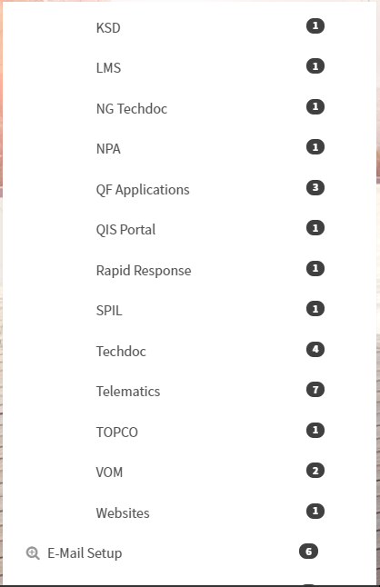
NAVIGATION
Service Catalog

Slide 6
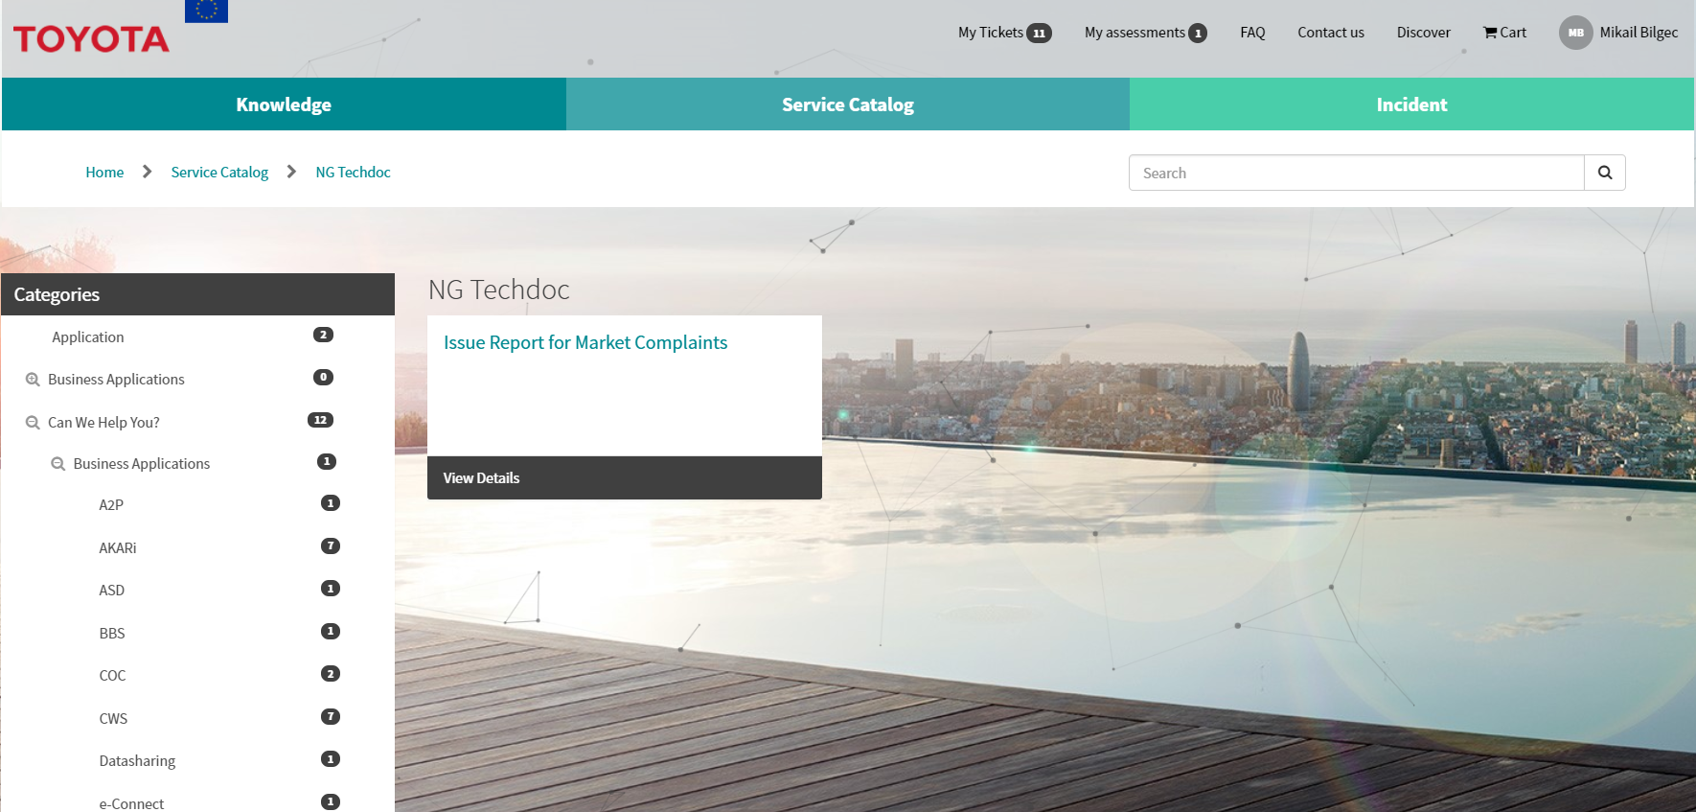
NAVIGATION
NG Techdoc

Slide 7
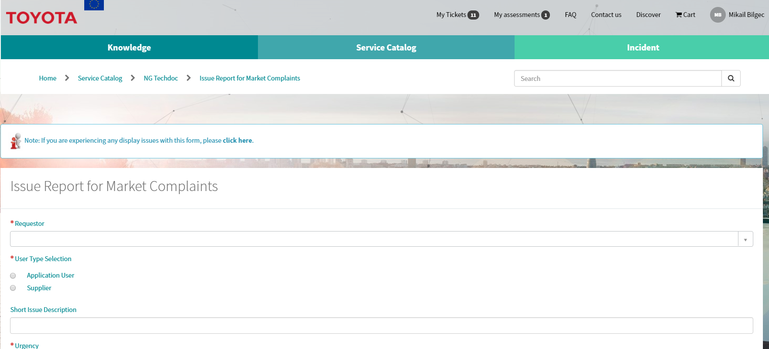
REPORTING
Issue Report for Market Complaints

Slide 8
REPORTING
Field information
* REQUIRED
Requestor: Enter your name and select from menu
User Type Selection: Application User. Unlocks new required field: “Issues”
Urgency: Select from menu
Attachments: Add screenshots, videos, logfiles, etc.

Slide 9
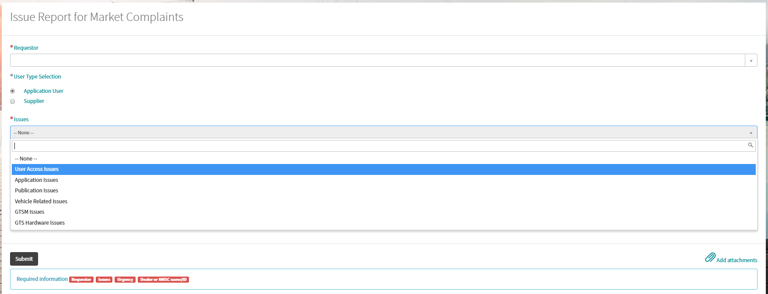
REPORTING
Issues Field
Select the relevant category here.

Slide 10
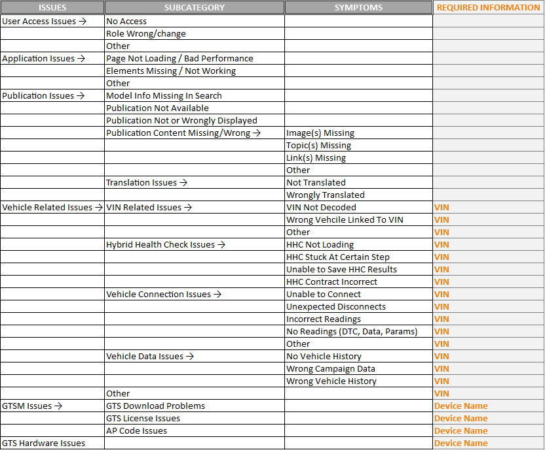
ISSUE TREE
Issues Field
All issues require “Urgency” and “Dealer/NMSC ID”.

Slide 11
ATTACHMENTS
Issues Field
Always include attachments. These can be logfiles, videos, screenshots
Button to edit attachment name
Button to remove attachment
To finish report, click on “Submit”

